Slide 1



an innovative approach to inform equitable growth

Slide 2




Steve
Donovan
Alan
Kishore

Slide 3
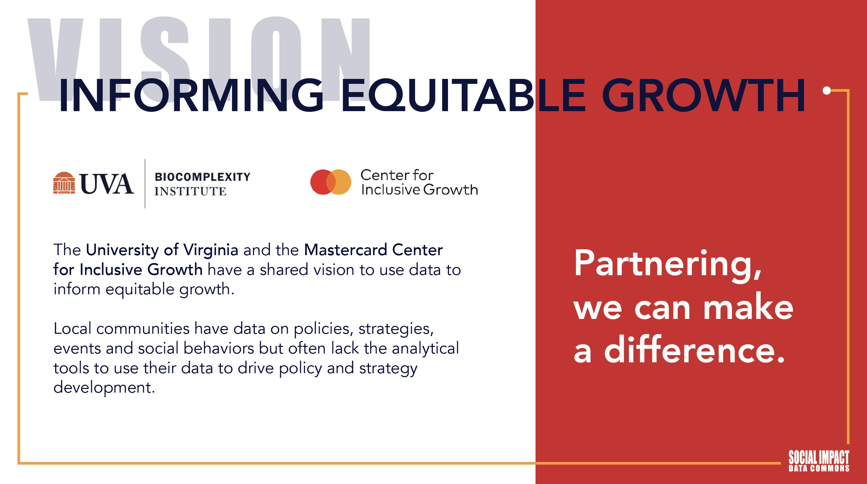

Slide 4
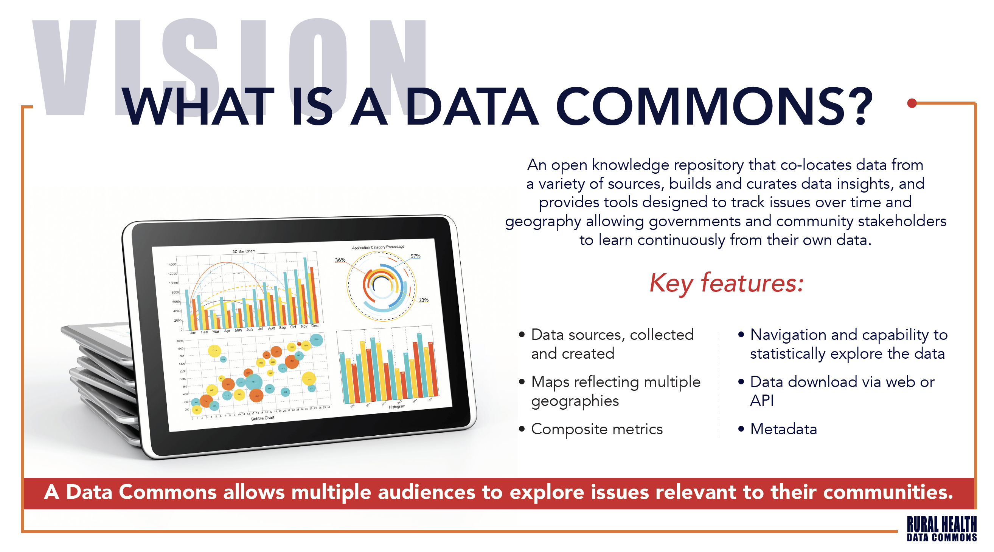

Slide 5
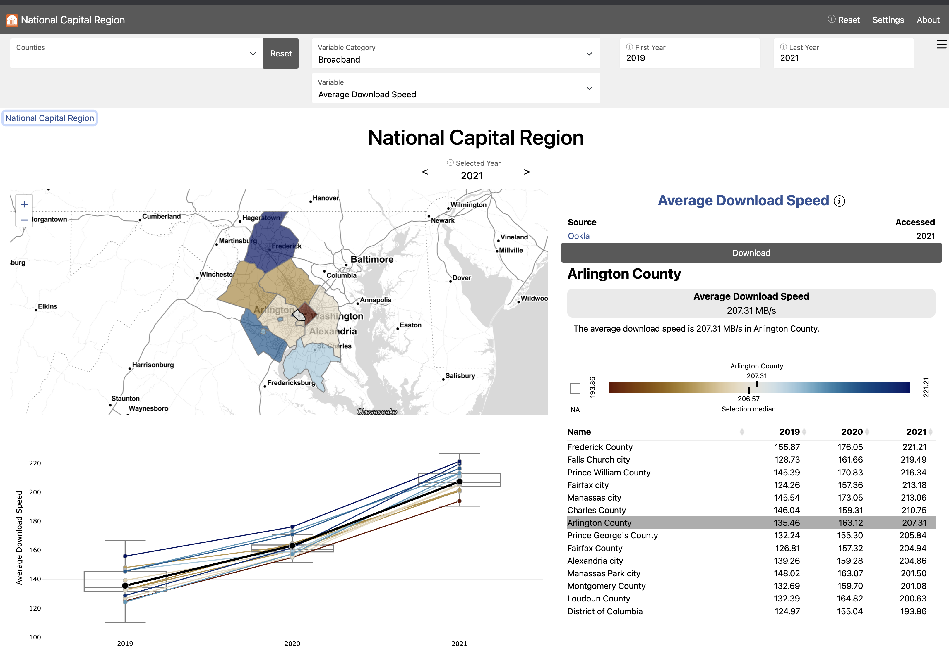
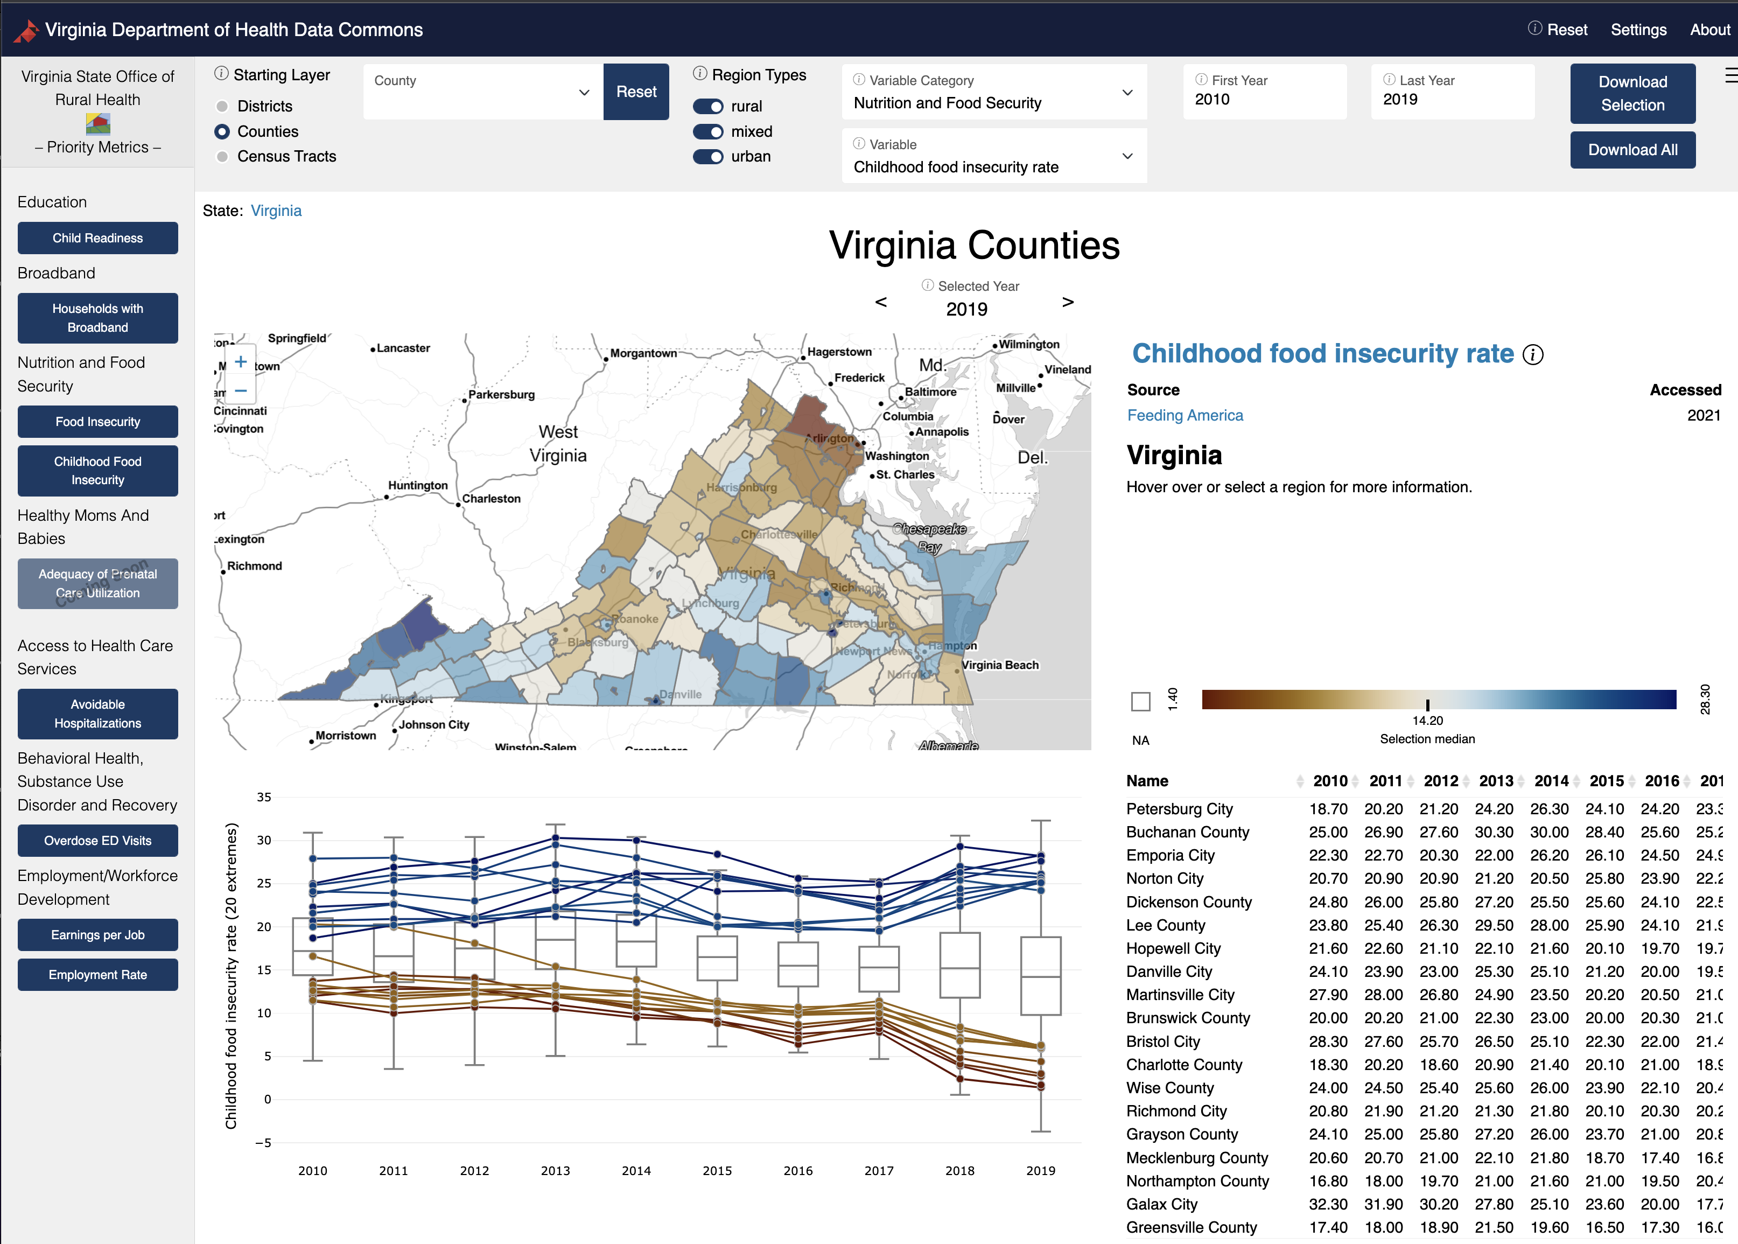
Two Data Commons Projects
1. Social Impact Data Commons to Inform Equitable Growth (Mastercard Center for Inclusive Growth) – National Capital Region
2. Data Commons to Support Department of Health Strategic Plans (Virginia Department of Health) – State of Virginia
Both applying the CLD Process to discover data needs
https://uva-bi-sdad.github.io/capital_region
https://uva-bi-sdad.github.io/vdh_rural_health_site

Slide 6
PROJECT APPROACH
Initial Grounding in Specific Local Issues
To kickoff the project, the team worked in partnership with Arlington County policymakers to identify several local social impact issues
These issues were selected on the basis that they can immediately benefit from the provision of new data and metrics and serve as powerful exemplars to showcase the impact and values of the Social Impact Data Commons as the project expands

Slide 7
Current Project Activities
Compared three Cost of Living Calculators
Analyzed various data sources in each calculator and found the best source
Took different sources, merged them and proposed a new calculator
Adjusted the algorithm and data sources in accordance with the local government’s demands at Fairfax County

Slide 8
Cost of Living
What is Cost of Living?
The cost of living is the amount of money needed to cover basic expenses such as housing, food, taxes, and healthcare in a certain place and time-period.
Why is Cost of Living important?
A cost-of-living adjustment is important because it allows employees, retirees and people living on fixed incomes to afford housing, goods, services and taxes as prices increase over time.
Use of Cost of Living
The cost of living is often used to compare how expensive it is to live in one city versus another.

Slide 9
Our Process
Sources From:
EPI Family Budget
MIT Living Wage
Washington Self Sufficiency
Our Calculator

Slide 10
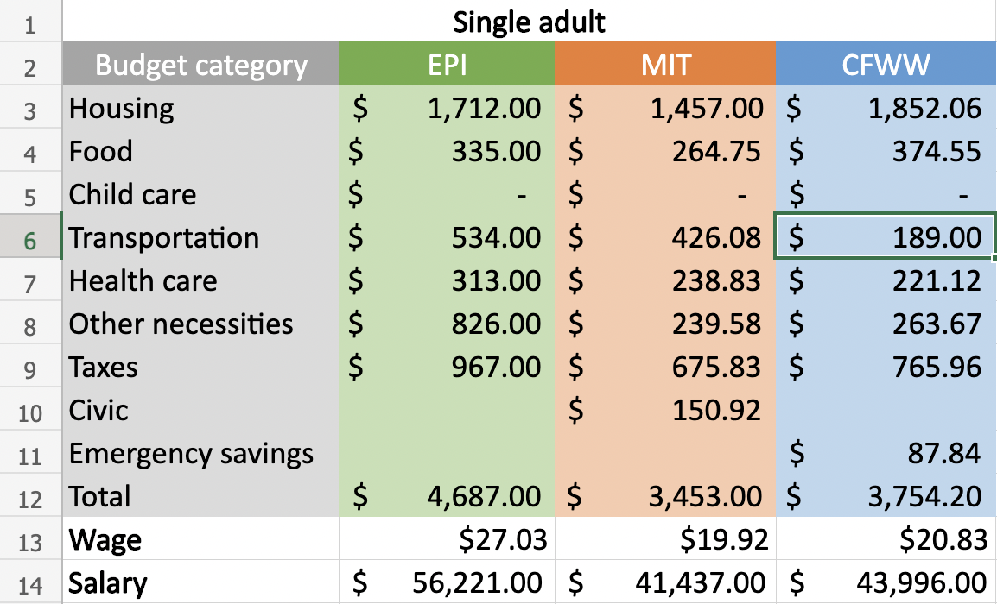
Comparison
Estimated cost for a Single Adult in Arlington County

Slide 11
Cost of Living Calculator
Category
Source
Cost of Living
Housing
American Community Survey
HUD
Food
USDA
Child Care
….
Feeding America
Child Care Aware
State Market Rate Surveys

Slide 12
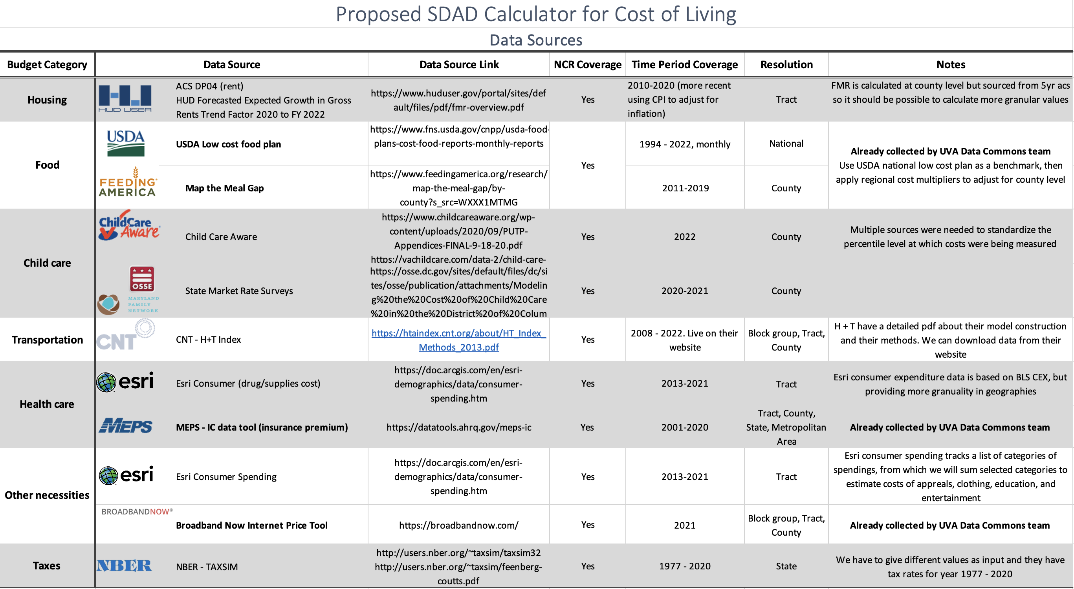
Our Calculator

Slide 13
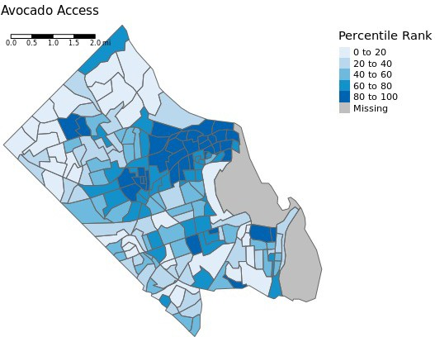
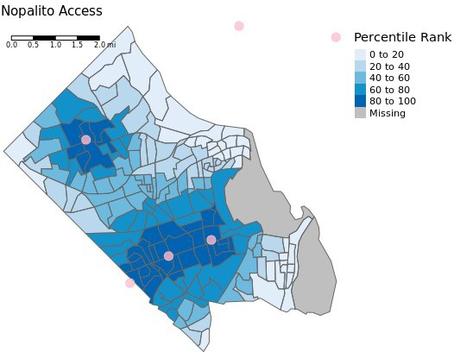
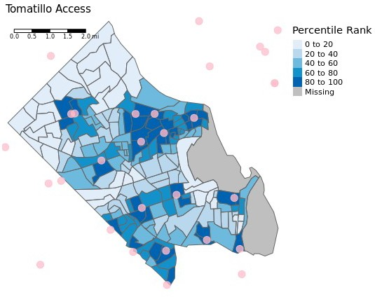
EQUITY & STABILITY OF STAPLE FOODS ACCESS
Relative access to individual food items using a gravity index Items can be combined to create culture-specific food baskets

Slide 14
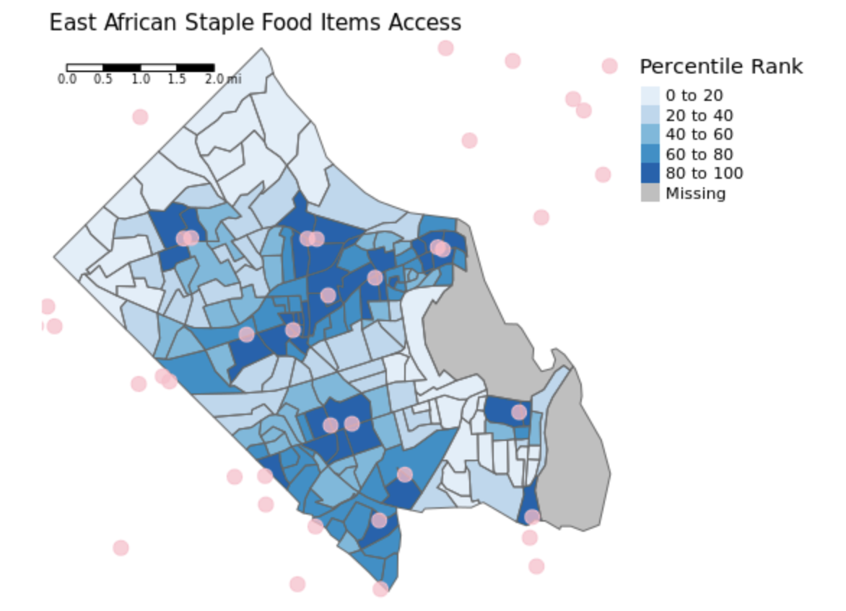
Equity & Stability of Staple Foods Access
Relative access using travel times and a gravity index

Slide 15
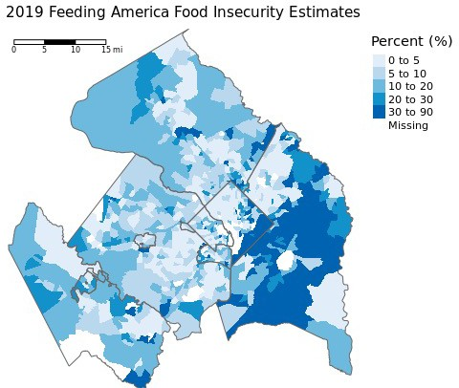
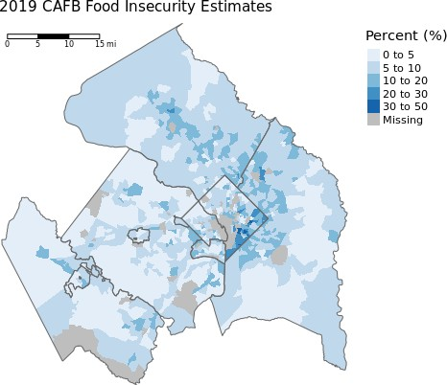
Equity & Stability of Staple Foods Access
Two Measures of Food Insecurity: Feeding America (National – adjusted to Census Tracts) and Capital Area Food Bank (Feeding America Local)

Slide 16
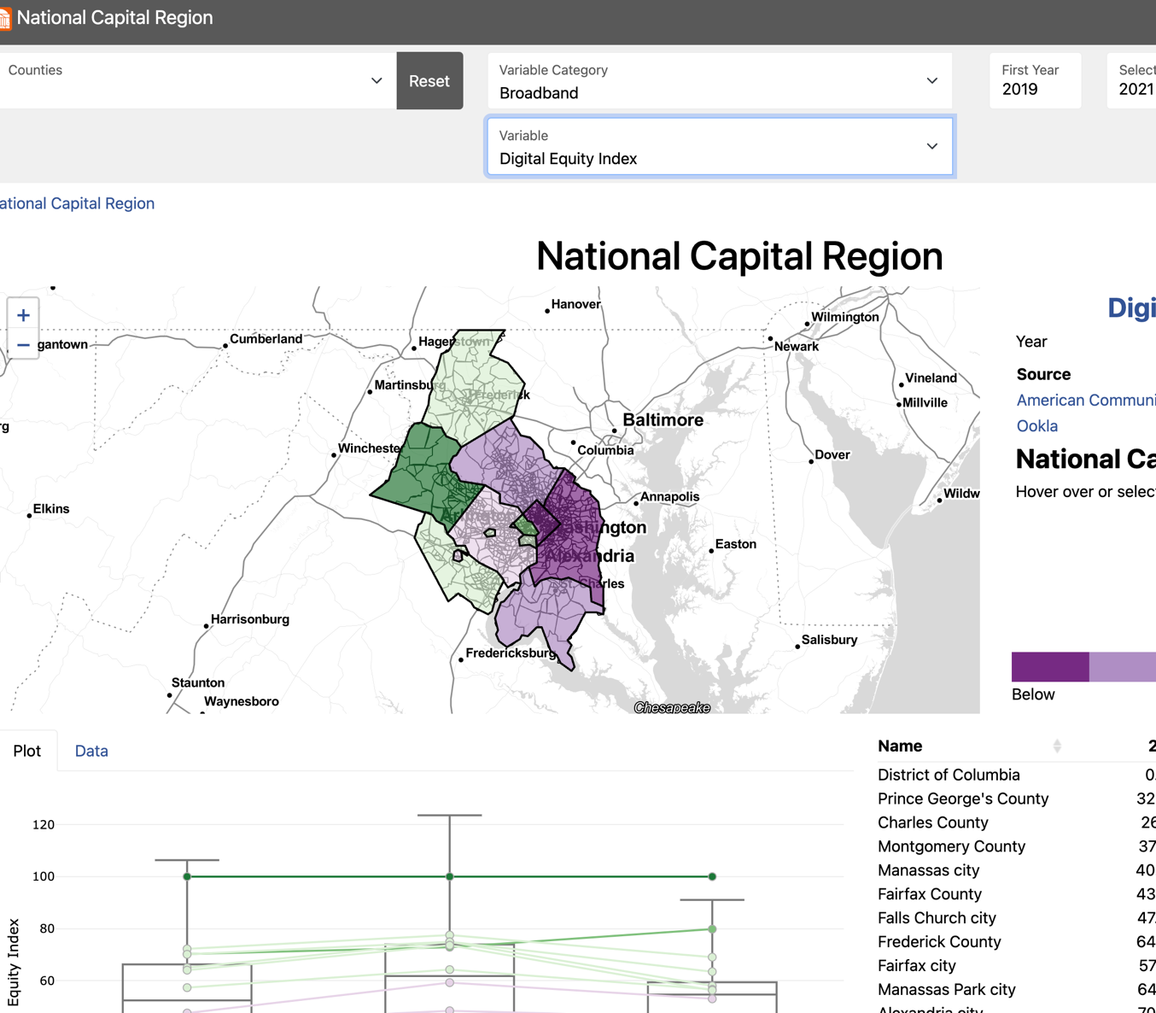
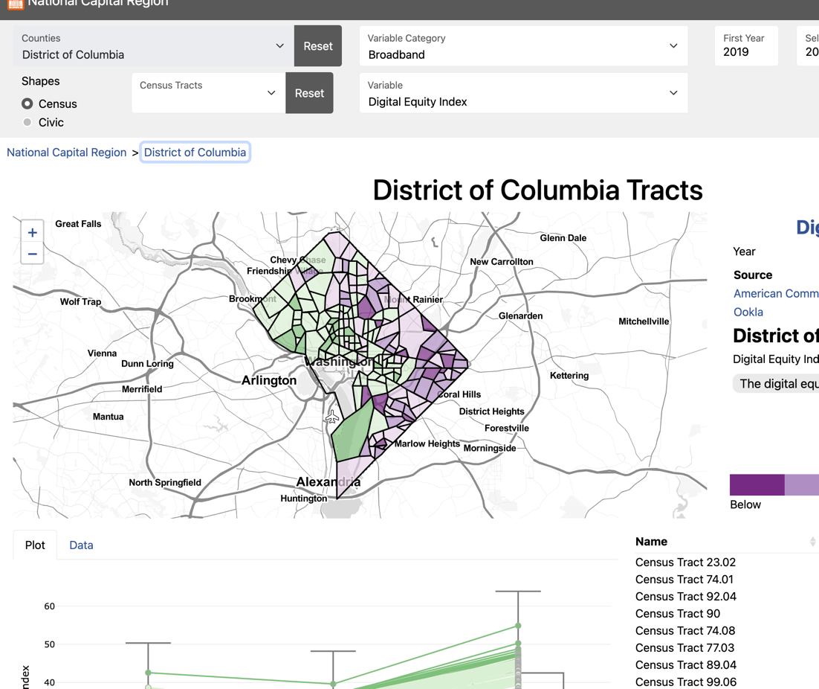
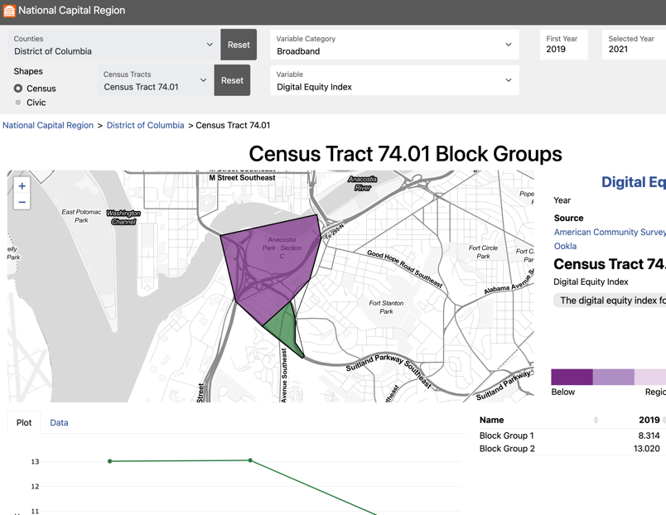
DATA COMMONS GENERALIZED ARCHITECTURE
Lightweight JavaScript WebApp, Universally Deployable: NCR Version (this project: beta): https://uva-bi-sdad.github.io/capital_region/ VDH Version (sister project: deployed, VA only): https://uva-bi-sdad.github.io/vdh_rural_health_site/

Slide 17
UPDATED ROUTING MACHINE
Robust OSRM Distance Calculation for Locations on the Edge of Virginia
Given a coordinate in Virginia,
How can we calculate the travel time to a grocery store?
Closest school, health care facilities?
Getting the distance right is important for calculating floating catchment areas (travel cost, distance decay function) to quantify accessibility
Notes:
This is important for calculating catchment areas, which utilizes the distance for its distance decay function, and travel cost. If the supply is above the

Slide 18
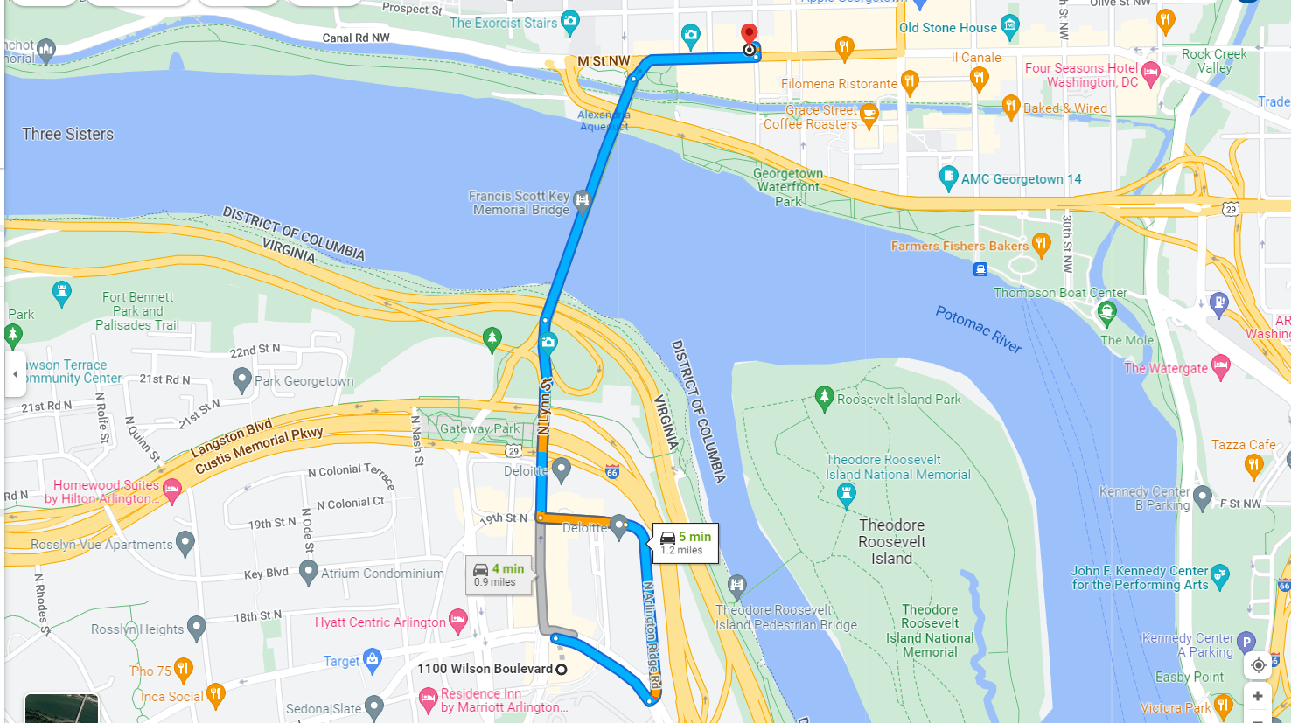
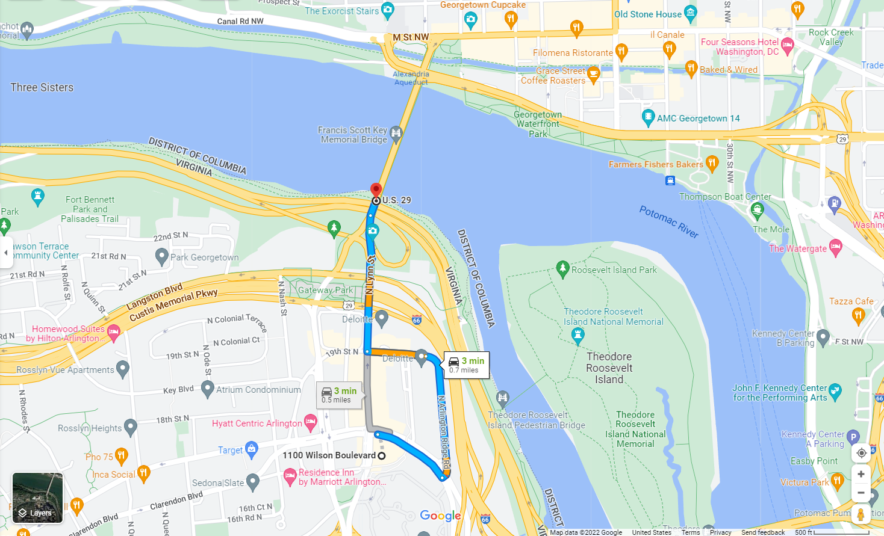
UPDATED ROUTING MACHINE
Robust OSRM Distance Calculation for Locations on the Edge of Virginia
Biocomplexity Institute to Georgetown Cupcakes with DC information
Biocomplexity Institute to Georgetown Cupcakes without DC information
We detected "snapping". When calculating paths to the closest food
source, our results we be incorrect

Slide 19
UPDATED ROUTING MACHINE
Robust OSRM Distance Calculation for Locations on the Edge of Virginia
Challenges
People living close to the state borders might have access to critical infrastructure in another state
We cannot perform millions of queries to servers such as Google Maps / OSRM
How can we test that our maps are valid on a subset of maps? Randomly selecting coordinates lead to invalid test cases (e.g., can you find a route between the ocean and the river?)

Slide 20

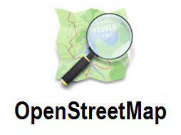

UPDATED ROUTING MACHINE
Robust OSRM Distance Calculation for Locations on the Edge of Virginia

Slide 21
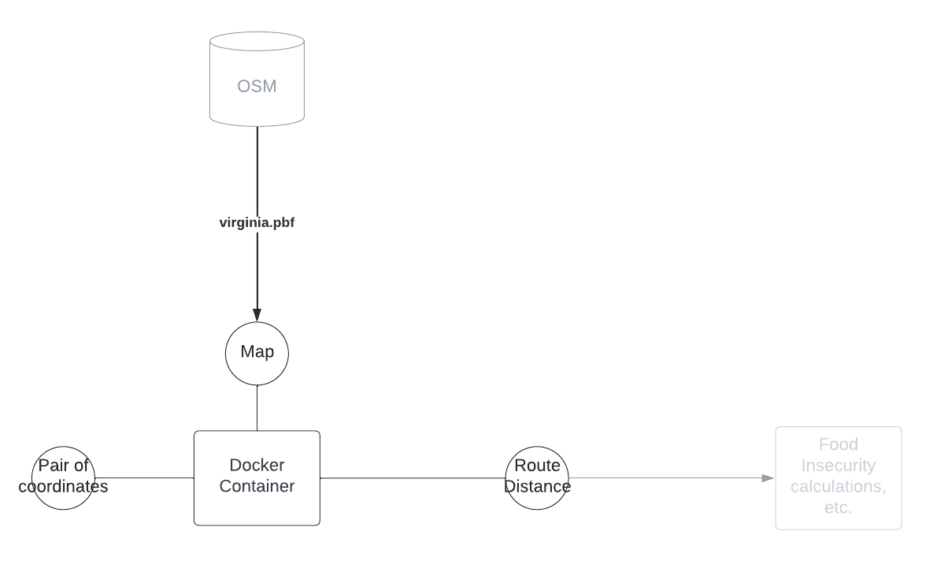
UPDATED ROUTING MACHINE
Robust OSRM Distance Calculation for Locations on the Edge of Virginia
Original Workflow

Slide 22
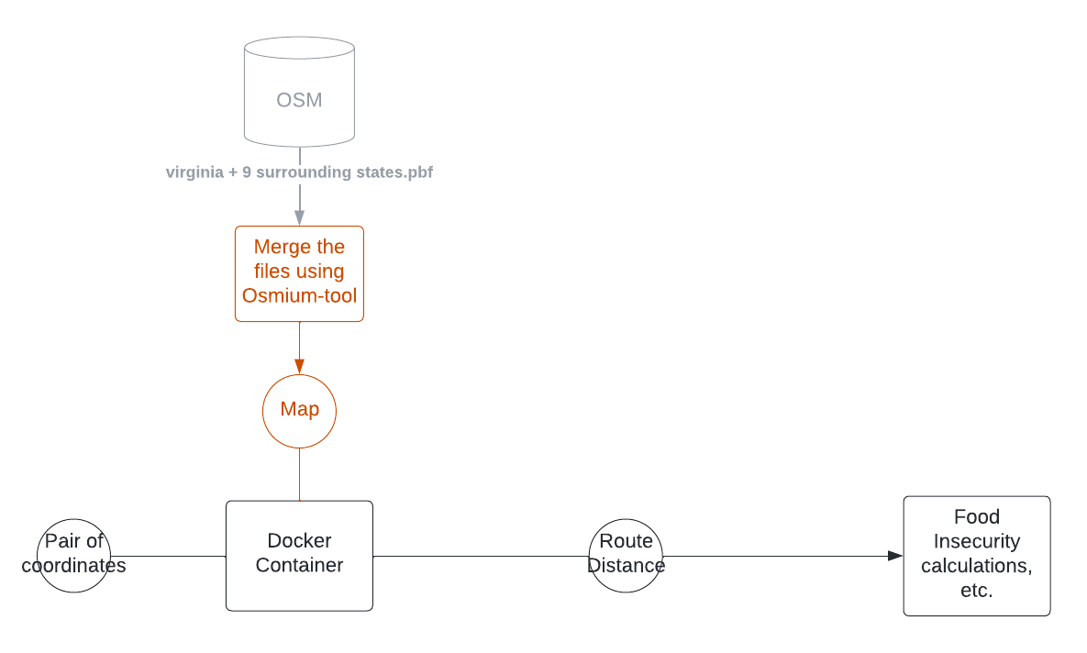
UPDATED ROUTING MACHINE
Robust OSRM Distance Calculation for Locations on the Edge of Virginia
Merge maps from surrounding states

Slide 23
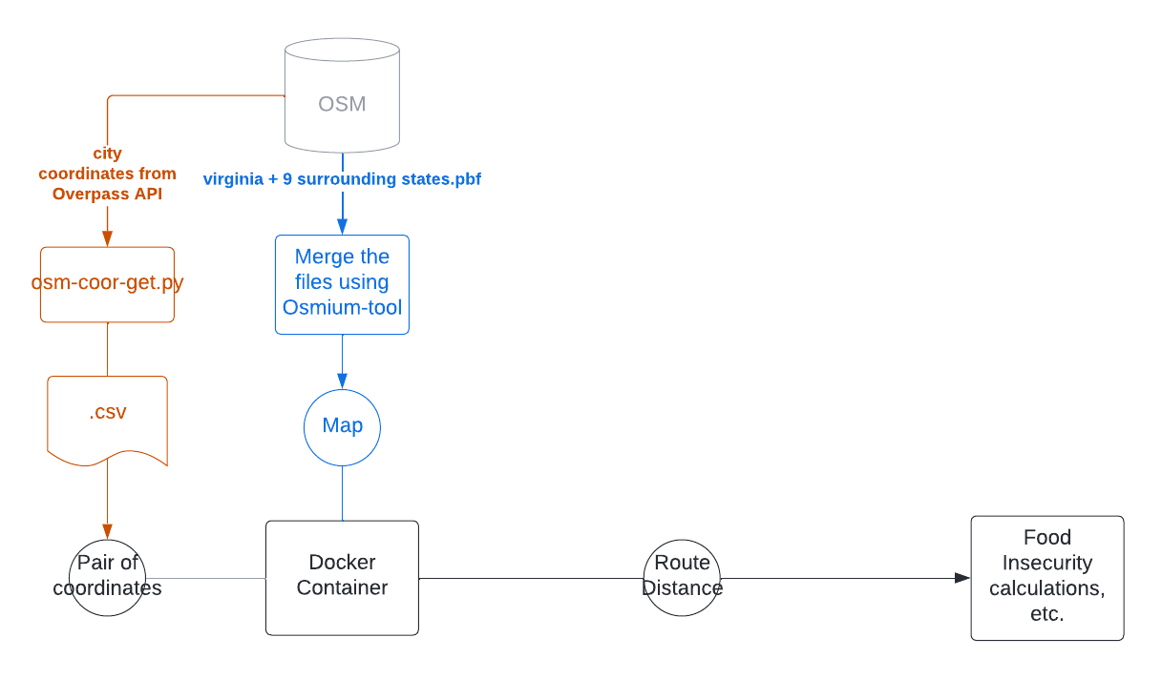
UPDATED ROUTING MACHINE
Robust OSRM Distance Calculation for Locations on the Edge of Virginia
Retrieve valid coordinates using cities in states

Slide 24
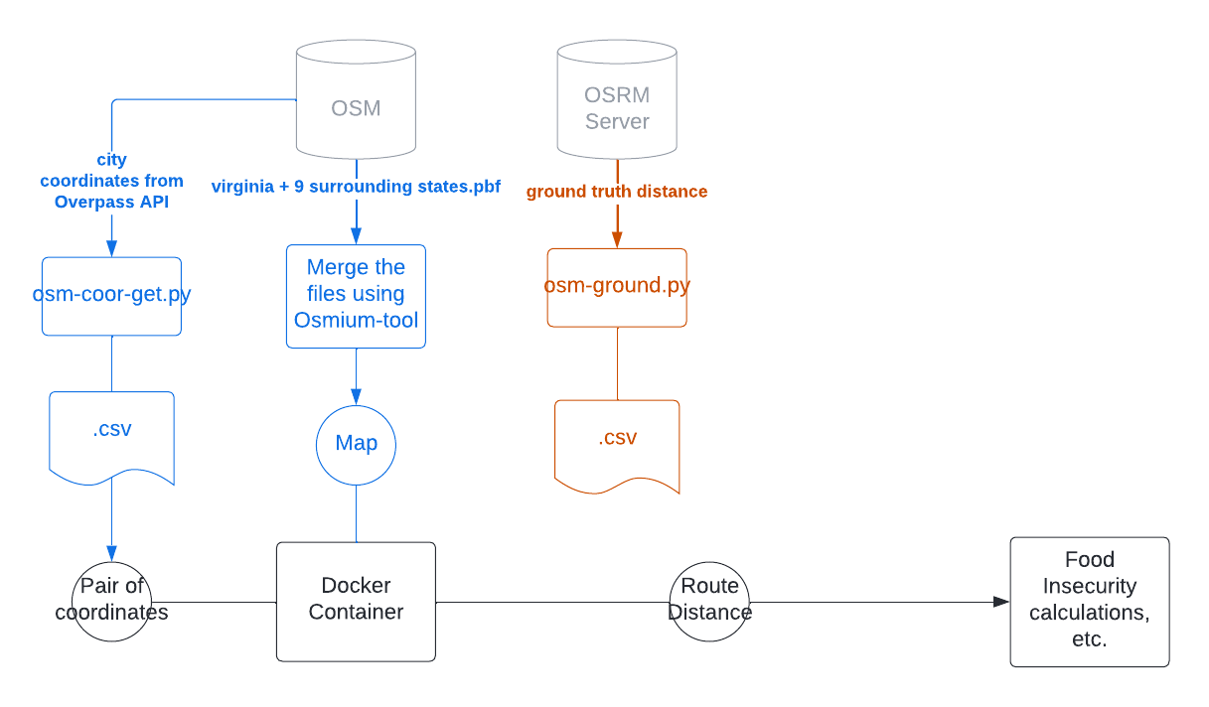
UPDATED ROUTING MACHINE
Robust OSRM Distance Calculation for Locations on the Edge of Virginia
Retrieve a ground truth set querying OSRM server

Slide 25
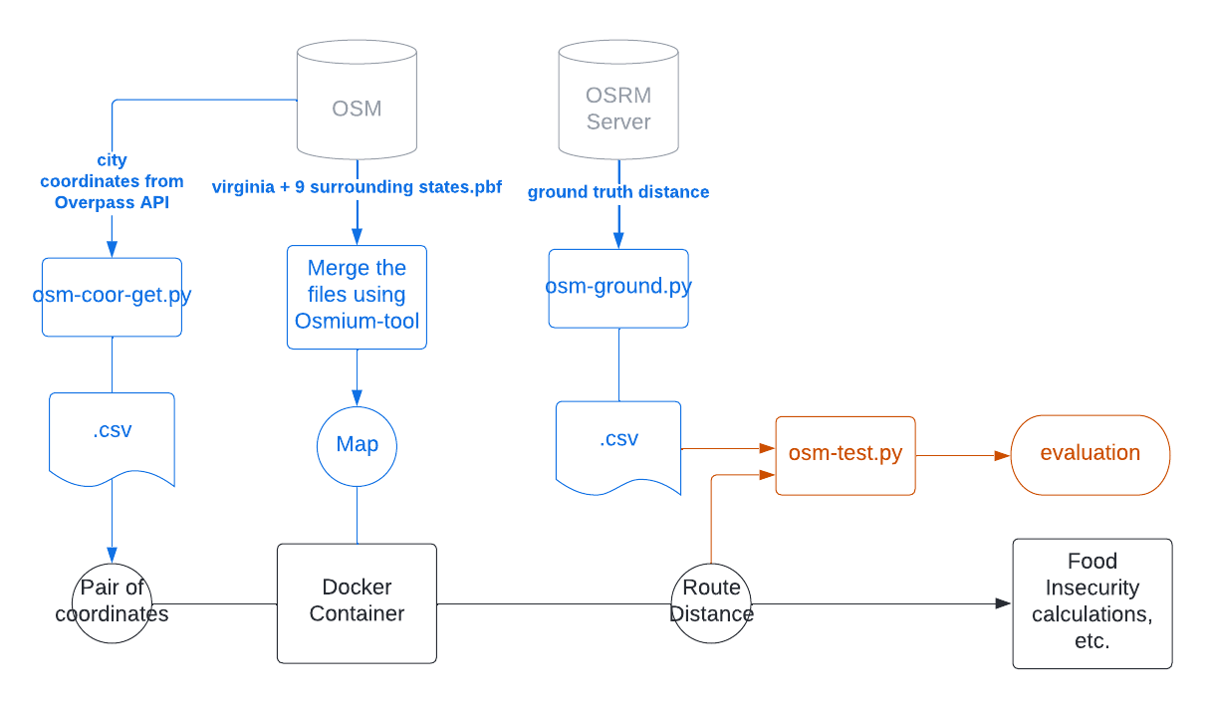
UPDATED ROUTING MACHINE
Robust OSRM Distance Calculation for Locations on the Edge of Virginia
Compare results and track differences

Slide 26
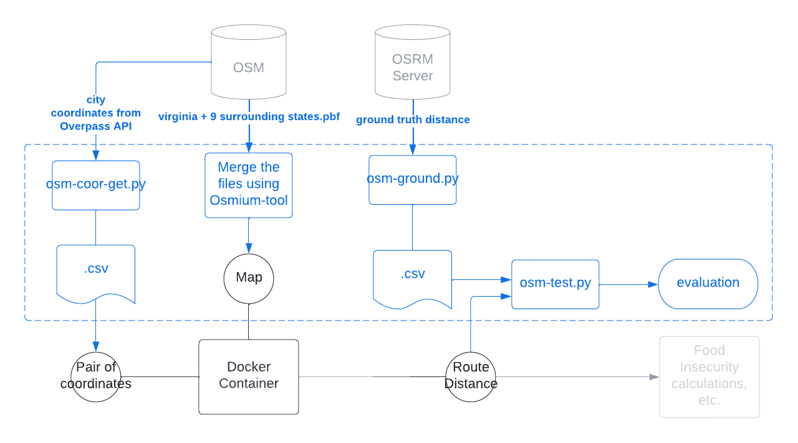
UPDATED ROUTING MACHINE
Robust OSRM Distance Calculation for Locations on the Edge of Virginia
Validation module complete

Slide 27


UPDATED ROUTING MACHINE
Robust OSRM Distance Calculation for Locations on the Edge of Virginia
Results
82% match with mean absolute difference of 1200 meters across 1000 cities between the 10 states
Open-sourced data collection and data validation on GitHub
Merge OSM Data
Testing OSRM

Slide 28
UPDATED ROUTING MACHINE
Robust OSRM Distance Calculation for Locations on the Edge of Virginia
Next Steps
Improve test cases around Virginia's edges
Look for ways to improve the existing user interface

